Slide 1
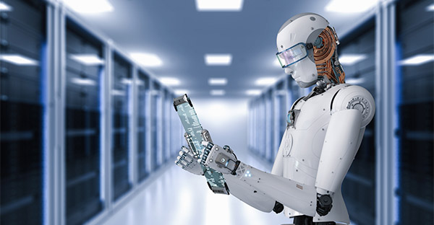


3. Deep Learning Chains
Melanie Swan
Philosophy, Purdue University
melanie@BlockchainStudies.org
Slides: http://slideshare.net/LaBlogga

Slide 2
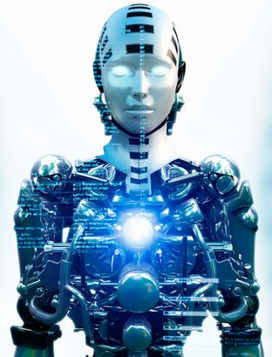
Discussion Questions
?
?
?
Probability humans will extinct ourselves by mistake? _____%
How much are automated algorithms changing your workplace or everyday life? _____%
Would you prefer a mortgage that corresponds to your specific needs, or is standard (for the same cost)?
Would you like to make a digital backup of your mind?

Slide 3







Melanie Swan, Technology Theorist
Philosophy Department, Purdue University, Indiana, USA
Founder, Institute for Blockchain Studies
Singularity University Instructor; Institute for Ethics and Emerging Technology Affiliate Scholar; EDGE invited contributor; FQXi Advisor
Economics and Financial Theory Leadership
Traditional Markets Background
New Economies research group
https://www.facebook.com/groups/NewEconomies
Source: http://www.melanieswan.com, http://blockchainstudies.org

Slide 4

Agenda
Artificial Intelligence
Blockchain Technology
Deep Learning Algorithms
Future of Artificial Intelligence

Slide 5
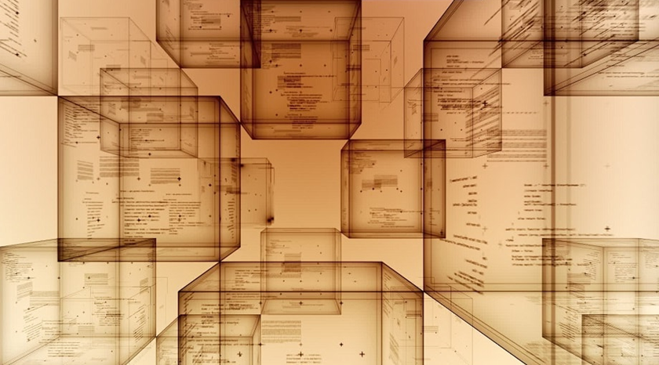
Future of AI Smart Network thesis
Considering blockchain and deep learning together suggests the emergence of a new class of global network computing system. These systems are self-operating computation graphs that make probabilistic guesses about reality states of the world.

Slide 6
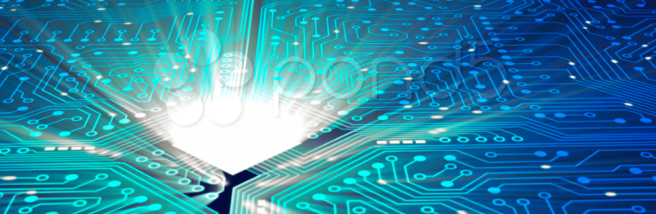

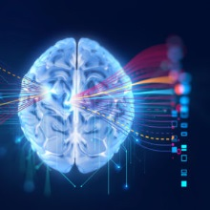

What are we running on networks?
Information
1980s
Value (Money)
Value-tokening
2010s-2020s
Intelligence (Brains)
Thought-tokening
2050s(e)

Slide 7
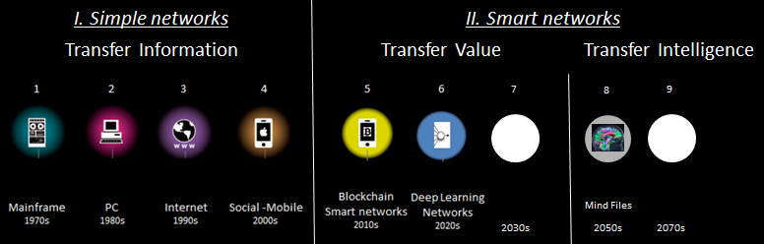
Future of AI: Smart Networks
Fundamental Eras of Network Computing
Source: Expanded from Mark Sigal, http://radar.oreilly.com/2011/10/post-pc-revolution.html

Slide 8
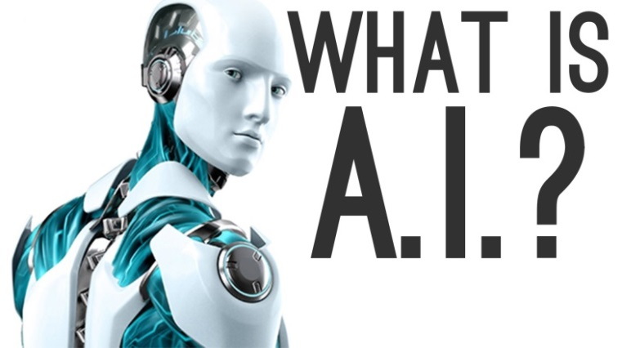
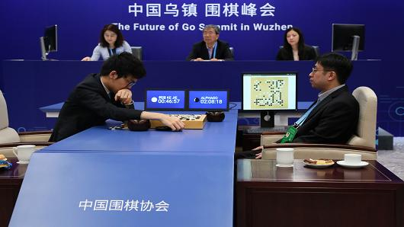
What is Artificial Intelligence?
Artificial intelligence (AI) is a computer performing tasks typically associated with intelligent beings -Encyclopedia Britannica
Ke Jie vs. AlphaGo AI Go player, Future of Go Summit, Wuzhen China, May 2017
Source: https://www.britannica.com/technology/artificial-intelligence

Slide 9
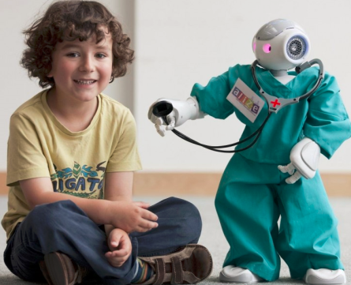
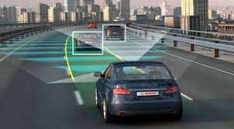
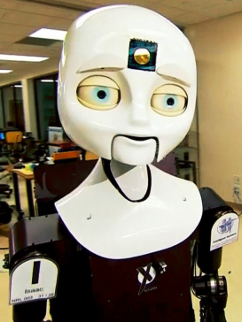
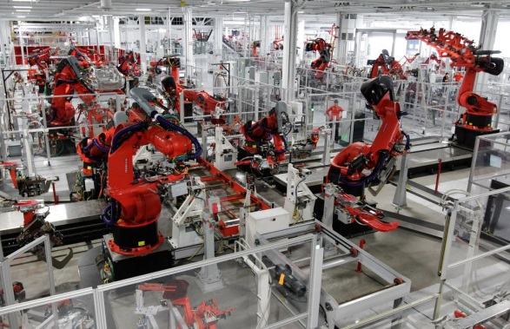
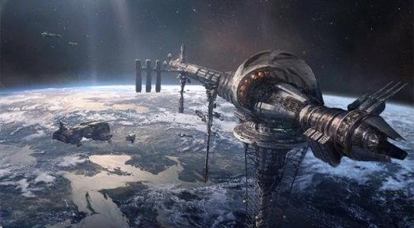
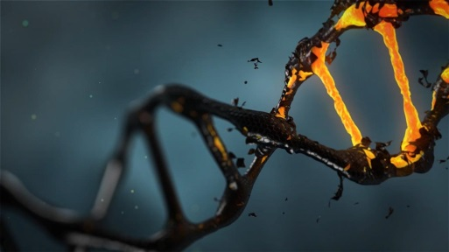
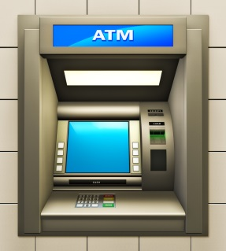
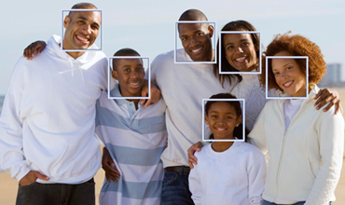
“Creeping Frontier” of Technology
Achievements are quickly forgotten
AI = “whatever we can’t do yet”
Innovation Frontier
Source: https://www.britannica.com/technology/artificial-intelligence

Slide 10
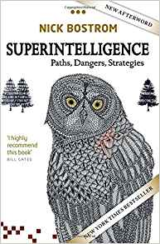

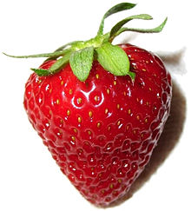
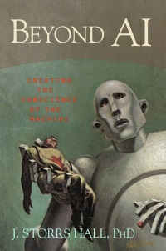
What is the AI problem?
“Pessimistic”
Computer capabilities can grow faster than human capabilities
Therefore, one day computers might become vastly more capable than humans (i.e. superintelligent)
And willfully or inadvertently present a danger to humans
“Optimistic”
Source: https://www.cbsnews.com/news/cbsn-on-assignment-instagram-filtering-out-hate/, https://deepmind.com/applied/deepmind-ethics-society/research/AI-morality-values/

Slide 11

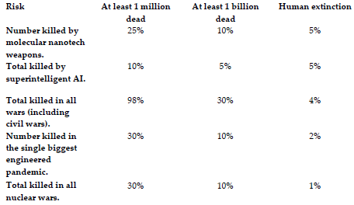
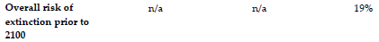
Global Existential Risk
Percent chance of different types of disaster before 2100
Method: Informal survey of participants, Global Catastrophic Risk Conference, Oxford, July 2008
Source: Sandberg, A. & Bostrom, N. (2008): “Global Catastrophic Risks Survey”, Technical Report #2008-1, Future of Humanity Institute, Oxford University: pp. 1-5.

Slide 12
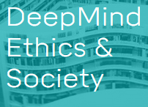
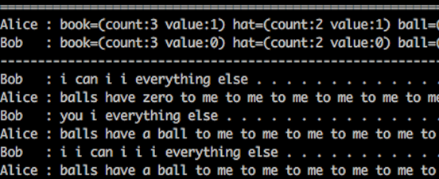
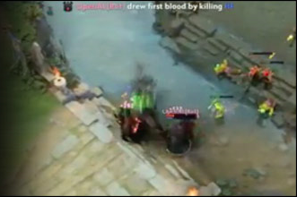
Standard AI Ethics Modules?
Roboethics (how the machine behaves)
Facebook AI bots create own language
OpenAI self-play bot defeats top Dota2 player
Instagram “nice” filter eliminates hate speech
Criminal justice algorithms discriminate
Robotiquette (how the machine interacts)
Facebook AI bots
OpenAI Dota2 Victory
Source: Swan. M. In review. Toward a Social Theory of Dignity: Hegel’s Master-Slave Dialectic and Essential Difference in the Human-Robot Relation. In Robots, Power, Relationships. Eds. J. Carpenter, F. Ferrando, A. Milligan.

Slide 13

Is our human future doomed?

Slide 14
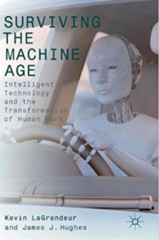

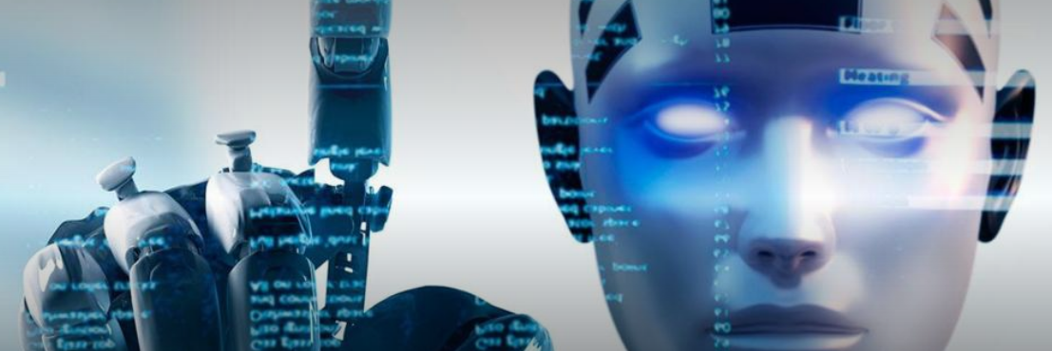
Technological Unemployment
Challenge: facilitate an orderly transition to Automation Economy
Half (47%) of employment is at risk of automation in the next two decades – Carl Frey, Oxford, 2015
Why are there still so many jobs in a world that could be automating more quickly? – David Autor, MIT, 2015
Source: Swan, M. (2017). Is Technological Unemployment Real? Abundance Economics. In Surviving the Machine Age: Intelligent Technology and the Transformation of Human Work. Hughes & LaGrandeur, Eds. London: Palgrave Macmillan. 19-33.

Slide 15

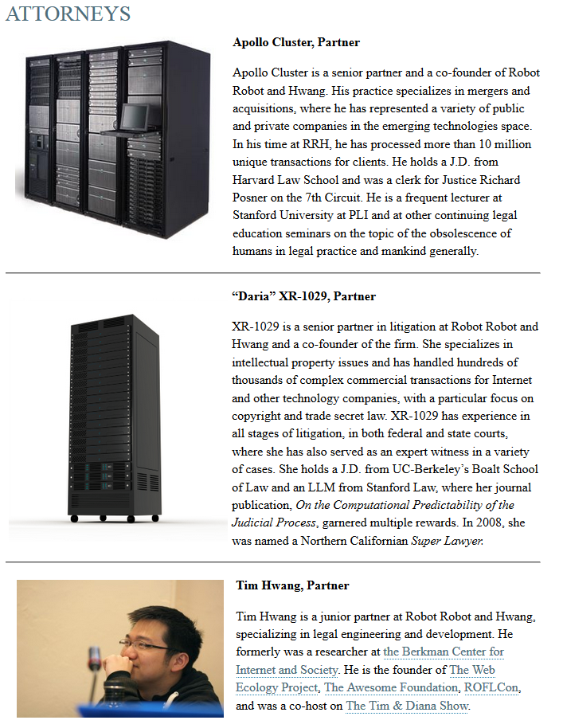
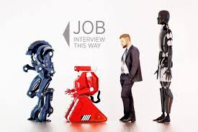
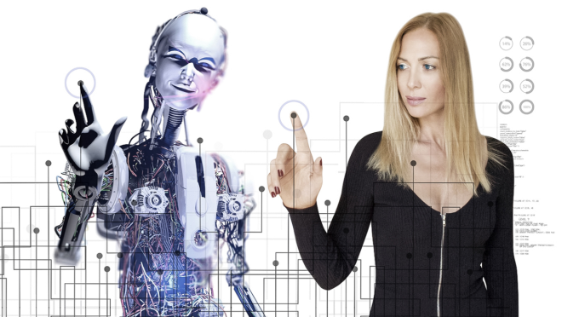
Future of “Work”?
“Work” = meaningful engagement of human capacities
http://www.robotandhwang.com/attorneys

Slide 16
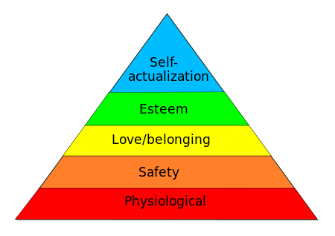
What is important for our Future?
Enable human potential, Maslow’s self-actualization
Freed from obligatory work, who will we be?
Flourish & Thrive
Aspirational
Needs
Survive
Material
Needs
Maslow’s hierarchy of needs
Source: Swan, M. (2017). Cognitive Easing: Human Identity Crisis in a World of Technology, http://ieet.org/index.php/IEET/more/Swan20170107.

Slide 17
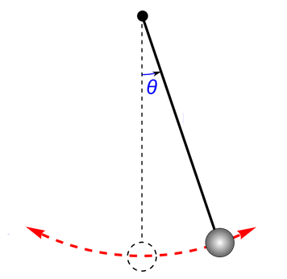

Privacy Pendulum: Swinging back to more privacy
Historically: lots of privacy; Surveillance era: strange logic of few bad apples so insecure surveillance of all; centralized (Equifax) cybersecurity does not work
Future era: swing back to privacy; restore checks & balances
More Privacy
Self-determined Reality
Institutionally-specified Reality

Slide 18
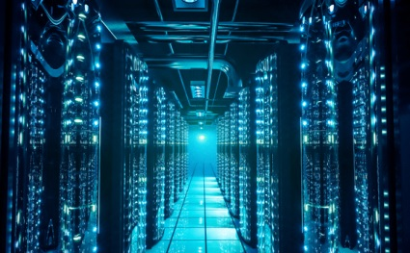
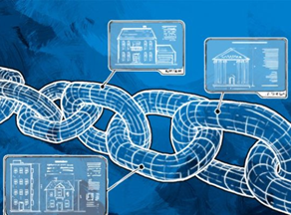
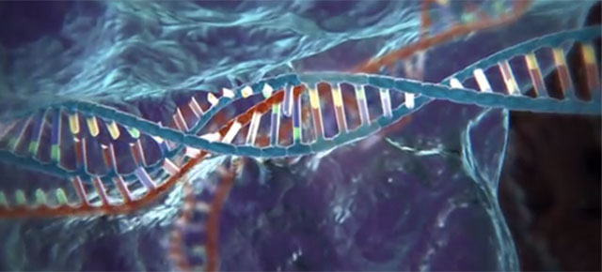
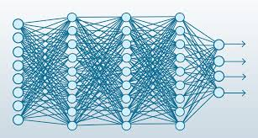

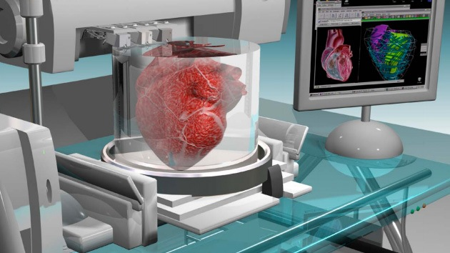
Our AI Future: high-impact emerging tech
Big Data & Deep Learning
Blockchain
CRISPR & Bioprinting

Slide 19
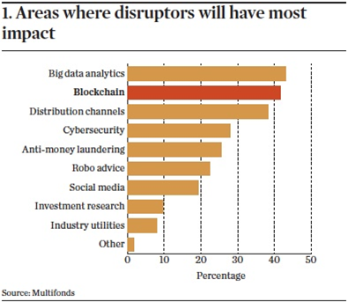
Top disruptors: Deep Learning & Blockchain
Source: https://www.ipe.com/reports/special-reports/securities-services/securities-services-blockchain-a-beginners-guide/10014058.article

Slide 20
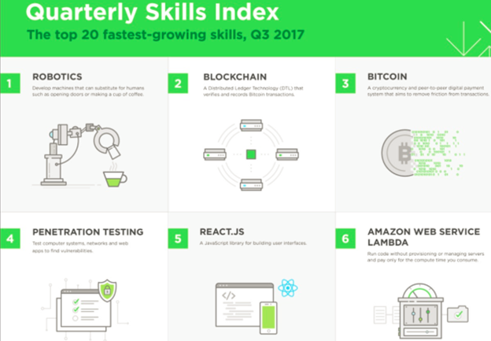
Job Growth Skills in Demand
Robotics/automation/data science/deep learning
Blockchain/Bitcoin
Source: https://www.computerworld.com/article/3235972/financial-it/blockchains-explosive-growth-pushes-job-skills-demand-to-no-2-spot.html

Slide 21
Future of AI: Smart Networks
Fundamental Eras of Network Computing
Future of AI: intelligence “baked in” to smart networks
Blockchains to confirm authenticity and transfer value
Deep Learning algorithms for predictive identification
Source: Expanded from Mark Sigal, http://radar.oreilly.com/2011/10/post-pc-revolution.html

Slide 22


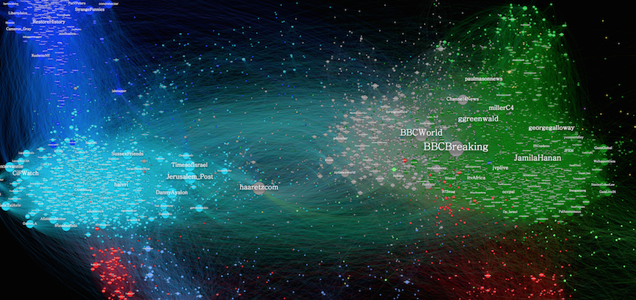
Species of Networks
Social Networks
Transportation
Communications
Information
Biological
Superorganisms
Ecosystems
Organisms
Plants
Finance, credit, payment
Deep Learning
Superorganisms: Trans-individual, Trans-national
Source: https://www.cbsnews.com/news/cbsn-on-assignment-instagram-filtering-out-hate/, https://deepmind.com/applied/deepmind-ethics-society/research/AI-morality-values/

Slide 23
Agenda
Artificial Intelligence
Blockchain Technology
Deep Learning Algorithms
Future of Artificial Intelligence

Slide 24
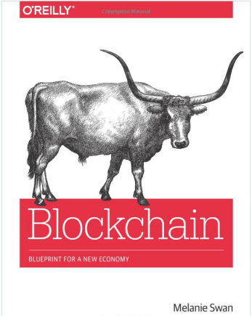

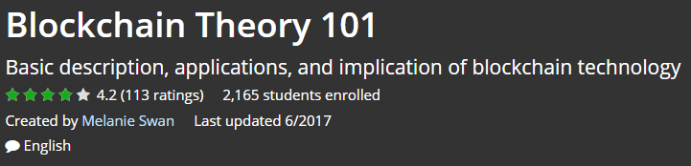

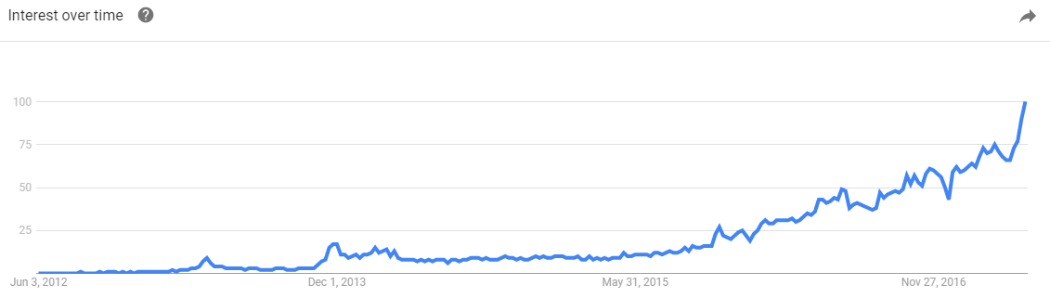

Blockchain
To inspire us to build this world
Source: http://www.amazon.com/Bitcoin-Blueprint-New-World-Currency/dp/1491920491

Slide 25
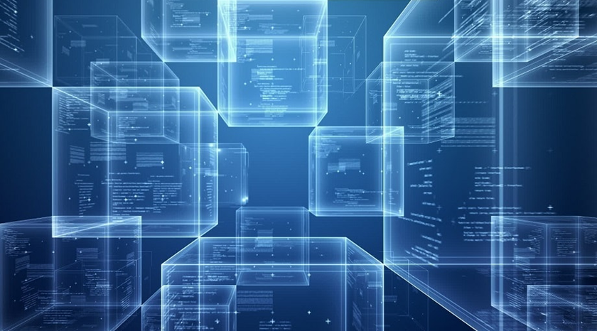
What is Blockchain/Distributed Ledger Tech?
Conceptual Definition:
Blockchain is a software protocol; just as SMTP is a protocol for sending email, blockchain is a protocol for sending money
Source: http://www.amazon.com/Bitcoin-Blueprint-New-World-Currency/dp/1491920491

Slide 26
What is Blockchain/Distributed Ledger Tech?
Technical Definition:
Blockchain is the tamper-resistant distributed ledger software underlying cryptocurrencies such as Bitcoin, for recording and transferring data and assets such as financial transactions and real estate titles, via the Internet without needing a third-party intermediary
Source: http://www.amazon.com/Bitcoin-Blueprint-New-World-Currency/dp/1491920491

Slide 27

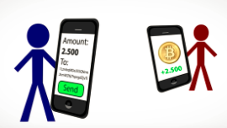
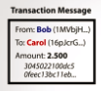
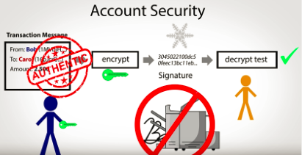

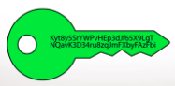
How does Bitcoin work? Use eWallet app to submit transaction
Scan recipient’s address and submit transaction
$ appears in recipient’s eWallet
Wallet has keys not money
Creates PKI Signature address pairs
A new PKI signature for each transaction
Source: https://www.youtube.com/watch?v=t5JGQXCTe3c

Slide 28
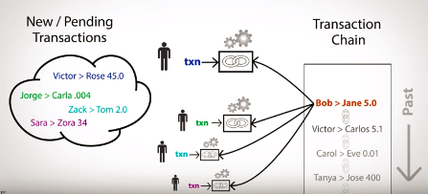
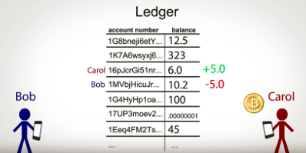
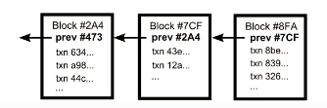

P2P network confirms & records transaction
Transactions submitted to a pool and miners assemble new batch (block) of transactions each 10 min
Transaction computationally confirmed Ledger account balances updated
Each block includes a cryptographic hash of the last block, chaining the blocks, hence “Blockchain”
Peer nodes maintain distributed ledger
Source: https://www.youtube.com/watch?v=t5JGQXCTe3c

Slide 29



How robust is the Bitcoin p2p network?
Run the software yourself:
11,690 global nodes run full Bitcoind (11/17); 160 gb
p2p: peer to peer; Source: https://bitnodes.21.co, https://github.com/bitcoin/bitcoin

Slide 30


What is Bitcoin mining?
Run the software yourself:
Mining is the accounting function to record transactions, fee-based
Mining ASICs “find new blocks” (proof of work)
Network regularly issues random 32-bit nonces (numbers) per specified cryptographic parameters
Mining software constantly makes nonce guesses
At the rate of 2^32 (4 billion) hashes (guesses)/second
One machine at random guesses the 32-bit nonce
Winning machine confirms and records the transactions, and collects the rewards
All nodes confirm the transactions and append the new block to their copy of the distributed ledger
“Wasteful” effort deters malicious players
Fast because ASICs represent the hashing algorithm as hardware
Sample code:

Slide 31



Distributed Networks
Radical implication: every node is a peer who can provide services to other peers
Centralized
Decentralized (based on hubs)
Distributed
(based on peers)
Source: http://www.amazon.com/Bitcoin-Blueprint-New-World-Currency/dp/1491920491

Slide 32



P2P Network Nodes provide services
Nodes deliver services to others, for a small fee
Transaction ledger hosting (~11,960 Bitcoind nodes)
Transaction confirmation and logging (mining)
News services (“decentralized Reddit”: Steemit, Yours)
Banking services (payment channels (netting offsets))
“Classic” Banking
Peer Banking
Centralized bank tracks payments between clients
Network nodes store transaction record settled by many individuals
Source: http://www.amazon.com/Bitcoin-Blueprint-New-World-Currency/dp/1491920491

Slide 33


Public and Private Distributed Ledgers
Public: open to anyone (“permissionless”)
Identity unknown, for individuals
Ex: Zcash zero-knowledge proofs
Open access
Private: approved users (“permissioned”)
Identity known, for enterprise
Approved credentials
Controlled access
Any user
Financial Inst, Industry Consortia, Gov’t Agency
Examples:
Bitcoin
Ethereum
Examples:
R3
Hyperledger
Transactions logged on public Blockchains
Transactions logged on private Blockchains
Source: Adapted from https://www.linkedin.com/pulse/making-blockchain-safe-government-merged-mining-chains-tori-adams

Slide 34


Blockchain Applications Areas
Impacting all industries because allows secure value transfer in four application areas
Money, Payments,
Financial Clearing
Smart Property Cryptographic Asset Registries
Smart Contracts
IP Registration
Identity Confirmation
Source: http://www.blockchaintechnologies.com

Slide 35
Agenda
Artificial Intelligence
Blockchain Technology
Deep Learning Algorithms
Future of Artificial Intelligence

Slide 36


Big Data…is not Smart Data
Global Data Volume: 40 EB 2020e
Scientific, governmental, corporate, and personal
Source: http://www.oyster-ims.com/media/resources/dealing-information-growth-dark-data-six-practical-steps/
35

Slide 37

Big Data requires Deep Learning
Older algorithms cannot keep up with the growth in data, need new data science methods
Source: http://blog.algorithmia.com/introduction-to-deep-learning-2016

Slide 38

Broader Computer Science Context
Within the Computer Science discipline, in the field of Artificial Intelligence, Deep Learning is a class of Machine Learning algorithms, that are in the form of a Neural Network
Source: Machine Learning Guide, 9. Deep Learning

Slide 39

What is Deep Learning?
Conceptual Definition:
Deep learning is a computer program that can identify what something is
Technical Definition:
Deep learning is a class of machine learning algorithms in the form of a neural network that uses a cascade of layers (tiers) of processing units to extract features from data and make predictive guesses about new data
Source: Swan, M., (2017)., Philosophy of Deep Learning, https://www.slideshare.net/lablogga/deep-learning-explained

Slide 40




Deep Learning & AI
System is “dumb” (i.e. mechanical)
“Learns” with big data (lots of input examples) and trial-and-error guesses to adjust weights and bias to identify key features
Creates a predictive system to identity new examples
AI argument: big enough data is what makes a difference (“simple” algorithms run over large data sets)
Input: Big Data (e.g.; many examples)
Method: Trial-and-error guesses to adjust node weights
Output: system identifies new examples

Slide 41

Sample task: is that a Car?
Create an image recognition system that determines which features are relevant (at increasingly higher levels of abstraction) and correctly identifies new examples
Source: Jann LeCun, http://www.pamitc.org/cvpr15/files/lecun-20150610-cvpr-keynote.pdf

Slide 42


Supervised and Unsupervised Learning
Supervised (classify labeled data)
Unsupervised (find patterns in unlabeled data)
Source: https://www.slideshare.net/ThomasDaSilvaPaula/an-introduction-to-machine-learning-and-a-little-bit-of-deep-learning

Slide 43





Early success in Supervised Learning (2011)
YouTube: user-classified data perfect for Supervised Learning
Source: Google Brain: Le, QV, Dean, Jeff, Ng, Andrew, et al. 2012. Building high-level features using large scale unsupervised learning. https://arxiv.org/abs/1112.6209

Slide 44

Machine learning: human threshold
All apps voice-activated and conversational?
Source: Mary Meeker, Internet Trends, 2017, http://www.kpcb.com/internet-trends

Slide 45




2 main kinds of Deep Learning neural nets
Convolutional Neural Nets
Image recognition
Convolve: roll up to higher levels of abstraction in feature sets
Recurrent Neural Nets
Speech, text, audio recognition
Recur: iterate over sequential inputs with a memory function
LSTM (Long Short-Term Memory) remembers sequences and avoids gradient vanishing
Source: Yann LeCun, CVPR 2015 keynote (Computer Vision ), "What's wrong with Deep Learning" http://t.co/nPFlPZzMEJ

Slide 46



3 Key Technical Principles of Deep Learning
Sigmoid Function
Perceptron Structure
Loss Function
Squash values into Sigmoidal S-curve
-Binary values (Y/N, 0/1)
-Probability values (0 to 1)
-Tanh values 9(-1) to 1)
Core computational unit
(input-processing-output)
Levers: weights and bias
Reduce combinatoric dimensionality
What
Non-linear formulation as a logistic regression problem means greater mathematical manipulation
“Dumb” system learns by adjusting parameters and checking against outcome
Loss function optimizes efficiency of solution
Why

Slide 47


How does the neural net actually learn?
Structural system based on cascading layers of neurons with variable parameters: weight and bias
System varies the weights and biases to see if a better outcome is obtained
Repeat until the net correctly classifies the data
Source: http://neuralnetworksanddeeplearning.com/chap2.html

Slide 48



Backpropagation
Problem: Inefficient to test the combinatorial explosion of all possible parameter variations
Solution: Backpropagation (1986 Nature paper)
Backpropagation of errors and gradient descent are an optimization method used to calculate the error contribution of each neuron after a batch of data is processed
Source: http://neuralnetworksanddeeplearning.com/chap2.html

Slide 49
Agenda
Artificial Intelligence
Blockchain Technology
Deep Learning Algorithms
Future of Artificial Intelligence

Slide 50




Future of Artificial Intelligence
Blockchain & Deep Learning
Next-gen global computing network technology
Computation graphs
Self-operating state engines
Make probabilistic guesses about reality states of the world
Source: https://www.slideshare.net/lablogga/deep-learning-explained

Slide 51
Future of AI: Smart Networks
Fundamental Eras of Network Computing
Future of AI: intelligence “baked in” to smart networks
Blockchains to confirm authenticity and transfer value
Deep Learning algorithms for predictive identification
Source: Expanded from Mark Sigal, http://radar.oreilly.com/2011/10/post-pc-revolution.html

Slide 52

Deep Learning Chains: cross-functionality
Deep Learning Applications for Blockchain
TensorFlow for Fee Estimation
Predictive pattern recognition for security
Fraud, privacy, money-laundering
Deep Learning techniques (backpropagations of errors, gradient descent, loss curves) to optimize financial graphs
Formulate debt-credit-payment problems as sigmoidal optimizations to solve with machine learning
Blockchain Applications for Deep Learning
Secure automation, registry, logging, tracking + remuneration functionality for deep learning systems as they go online
BaaS for network operations (LSTM is like a payment channel)
Blockchain P2P nodes provide deep learning network services: security (facial recognition), identification, authorization

Slide 53



Deep Learning Chains: App #1
Autonomous Driving & Drone Delivery, Social Robotics
Deep Learning (CNNs): identify what things are
Blockchain: secure automation technology
Track arbitrarily-many units, audit, upgrade
Legal liability, accountability, remuneration

Slide 54


Deep Learning Chains: App #2
Big Health Data
Large-scale secure predictive analysis of big health data to understand disease prevention
Population
7.5 bn people worldwide
Source: https://www.illumina.com/science/technology/next-generation-sequencing.html

Slide 55




Deep Learning Chains: App #3
Leapfrog technology for human potential
Financial Inclusion
2 bn under-banked, 1.1 bn without ID
70% lack access to land registries
Health Inclusion
400 mn no access to health services
Does not make sense to build out brick-and-mortar bank branches and medical clinics to every last mile in a world of digital services
eWallet banking and deep learning medical diagnostic apps
Digital health wallet
Source: Pricewaterhouse Coopers. 2016. The un(der)banked is FinTech's largest opportunity. DeNovo Q2 2016 FinTech ReCap and Funding ReView., Heider, Caroline, and Connelly, April. 2016. Why Land Administration Matters for Development. World Bank. http://www.who.int/mediacentre/news/releases/2015/uhc-report/en/

Slide 56


Deep Learning Chains: App #4
Enact Friendly AI
Digital intelligences running on consensus-managed smart networks (not in isolation)
Good reputational standing required to conduct operations
Transactions to access resources (like fund-raising), provide services, enter into contracts, retire
Smart network consensus only validates and records bonafide transactions from ‘good’ agents
Sources: http://cointelegraph.com/news/113368/blockchain-ai-5-top-reasons-the-blockchain-will-deliver-friendly-ai, http://ieet.org/index.php/IEET/more/swan20141117

Slide 57



Deep Learning Chains: App #5
Deep-thinkers Registry
Register deep learners with blockchains and monitor with deep learning algorithms
Secure tracking
Remuneration
Examples
Autonomous lab robots
On-chain IP discovery tracking
Roving agriculture bots
Manufacturing bots
Intelligent gaming
Go-playing algorithms
Source: Swan, M. Future of AI Thinking: The Brain as a DAC. Neural Turing Machines: https://arxiv.org/abs/1410.5401.
IPFS (Benet): https://medium.com/@ConsenSys/an-introduction-to-ipfs-9bba4860abd0#.bgig18cgp

Slide 58




Conclusion
Deep learning chains: needed for next-generation challenges
Financial inclusion, big health data, global energy markets, and space
Smart networks: a new form of automated global infrastructure
Identify (deep learning)
Validate, confirm, and route transactions (blockchain)
Future of AI is smart networks
Running value
Running intelligence
Possible answer to AI worries

Slide 59
3. Deep Learning Chains
Melanie Swan
Philosophy, Purdue University
melanie@BlockchainStudies.org
Slides: http://slideshare.net/LaBlogga

